Slide 1

TAG Meeting May 18, 2010
ElectriCities Office
Raleigh, NC
1

Slide 2
TAG Meeting Agenda
Introductions and Agenda – Rich Wodyka
2010 Study Activities Report and 2010 Study Scope Update – Denise Roeder
Regional Studies Update – Bob Pierce
NERC TPL-001-1 Standard Update – Bob Pierce
NERC / FERC activities related to transmission planning – Bob Pierce
2010 TAG Work Plan – Rich Wodyka
TAG Open Forum – Rich Wodyka
2

Slide 3
NCTPC 2010 Study Activities
Denise Roeder
ElectriCities
3
Notes:
Hello I’m here to give you a summary of the 2010 NCTPC Study Scope and the status of the activities taken by the Planning Working Group this year to accomplish that scope. The scope was distributed to the TAG group for comment last December and was approved by the OSC in January of this year.

Slide 4
Purpose of Study
Assess Duke and Progress transmission systems' reliability and develop a single Collaborative Transmission Plan
Also assess Enhanced Access Study requests provided by Participants or TAG members
4

Slide 5
Steps and Status of the Study Process
1. Assumptions Selected
2. Study Criteria Established
3. Study Methodologies Selected
4. Models and Cases Developed
5. Technical Analysis Performed
6. Problems Identified and Solutions Developed
7. Collaborative Plan Projects Selected
8. Study Report Prepared
Completed
5

Slide 6
Study Assumptions Selected
Study Years for reliability analyses:
Near-term: 2015 Summer, 2015/2016 Winter
Longer-term: 2020 Summer
LSEs provided:
Input for load forecasts and resource supply assumptions
Dispatch order for their resources
Interchange coordinated between Participants and neighboring systems
6
Notes:
This is our fifth collaborative study, the first being the 2006 Collaborative Study.
Every year as part of the process to develop that year’s study, the Participants share information about their load and resource projections. We have completed the tasks of gathering and verifying the load forecasts and resources, as well as the resource dispatch order, that will be used in this year’s study.
We have also completed the update and coordination of the interchange between the Duke and Progress control areas and other neighboring control areas.

Slide 7
Study Criteria Established
NERC Reliability Standards
Current standards for base study screening
Current SERC Requirements
Individual company criteria
7
Notes:
The study will be assessed against typical planning criteria:
NERC Requirements
SERC Requirements
Duke and PEC criteria (voltage, thermal, stability, short circuit, and phase angle)

Slide 8
Study Methodologies Selected
Thermal Power Flow Analysis – primary methodology
Voltage, stability, short circuit, phase angle analysis - as needed
Each system (Duke and Progress) will be tested for impact of other system’s contingencies
8
Notes:
Assumes that thermal limits will be the controlling limit for the reliability plan.
In the study we will look for overloaded facilities
Contingency analysis for both Duke and PEC will be used.
We will monitor facilities as normal plus the collaborative study will allow for more detailed analysis of cross-company contingency impacts.
Voltage, stability, phase angle, and short circuit analysis will performed as needed.
Identify transmission elements approaching their limits.
Report results based on
Thermal loadings greater than 90%
Voltages less than 100% for 500kV and less than 95% for 230kV, 115kV, and 100kV buses; pre- to post-contingency voltage drops of 5% or more.

Slide 9
Base Case Models Developed
Latest available MMWG cases were selected and updated for study years
Adjustments were made based on additional coordination with neighboring transmission systems
Combined detailed model for Duke and Progress was prepared
Planned transmission additions from updated 2009 Plan were included in models
9
Notes:
At the beginning of each year, both Duke and PEC are preparing their updated power flow models. This cycle is driven by the industry and NERC MMWG.
Chose to start with MMWG model, because it’s most up-to-date available, particularly for outside systems.
Each company builds out their own detailed models and then these are combined to build the joint model used by the NCTPC.
Each company’s transmission plans are included in their models.
Representatives of the Collaborative have engaged PJM and South Carolina utilities to discuss topics relating to the NCTPC interface with each of them in order to improve the model assumptions for those neighboring areas.
Adjustments for neighboring systems include getting more up-to-date information than what’s currently in the regional model (e.g., removing PATH and MAPP backbone projects in PJM) or getting more detailed system information (e.g., “market dispatch” representative of what’s in inter-regional models within SERC).
Each company has built its detailed model, and those models have been merged.

Slide 10
Resource Supply Options Selected
Last year
Hypothetical import/export scenarios
Hypothetical new base load generation
This year
Retire & replace existing coal generation
Off-shore wind
10
Notes:
Typically we have alternated from one study year to the next between studying a set of imports to studying other types of options in an effort to get more valuable information from this process.

Slide 11
Retire & Replace Coal Generation
Retire 100% existing un-scrubbed coal by 2015, approximately
1,500 MW for Progress
2,000 MW for Duke
Replace with hypothetical new generation and/or imports
11

Slide 12
Off-Shore Wind
Approximately 3,300 MW total capacity
Injected at three locations on Progress system
MW allocation – 60% Duke, 40% Progress
Injection Point | On-peak MW (30-40% CF) | Off-peak MW (90% CF)
Wilmington | 125 | 375
Morehead City | 675 | 1,500
Bayboro | 425 | 1,125
TOTAL | 1,225 | 3,000
12
Notes:
Basis – June 2009 study by UNC, “Coastal Wind Energy for North Carolina’s Future - A Study of the Feasibility of Wind Turbines in the Pamlico and Albemarle Sounds and in Ocean Waters Off the North Carolina Coast”
Objective is to assess transmission capacity (not to evaluate operational issues). Determined that the upper range of off peak load combined with transporting high capacity of offshore wind energy would yield most severe condition, i.e., would place the greatest stress on the transmission system from a thermal capacity point of view. Therefore, for off-peak case, chose period reflective of “shoulder” period to set system load levels and determine the need for transmission infrastructure at that point. That means assuming the load on the two systems is at about 70-75% of peak, or about 13,000 MW for Duke and 9,000 MW for Progress.
For off-peak case will scale load and re-dispatch generation.
Assume wind energy will be integrated into the system via three offshore collector stations near each of the injection points. Assumptions do not include the infrastructure required to get from the resource to the collector stations – attachment costs are up to the developer and will not be evaluated here.
Have developed initial strawman of transmission infrastructure needed to tie into the Progress transmission system. This first cut of proposed transmission additions does not build in complete redundancy for delivering maximum capacity from the resources. Will run initial screening this way and identify where additional infrastructure would be needed to address violations of reliability criteria (N-1). The alternative is to assume you will curtail the generation to avoid violating reliability criteria.
60:40 Duke:Progress allocation of MWs based on load ratio share at peak → translates to On-peak = 735:490 Off-peak = 1,800:1,200

Slide 13
This page intentionally blank
13
Notes:
Basis – June 2009 study by UNC, “Coastal Wind Energy for North Carolina’s Future - A Study of the Feasibility of Wind Turbines in the Pamlico and Albemarle Sounds and in Ocean Waters Off the North Carolina Coast”
Objective is to assess transmission capacity (not to evaluate operational issues). Determined that the upper range of off peak load combined with transporting high capacity of offshore wind energy would yield most severe condition, i.e., would place the greatest stress on the transmission system from a thermal capacity point of view. Therefore, for off-peak case, chose period reflective of “shoulder” period to set system load levels and determine the need for transmission infrastructure at that point. That means assuming the load on the two systems is at about 70-75% of peak, or about 13,000 MW for Duke and 9,000 MW for Progress.
For off-peak case will scale load and re-dispatch generation.
Assume wind energy will be integrated into the system via three offshore collector stations near each of the injection points. Assumptions do not include the infrastructure required to get from the resource to the collector stations – attachment costs are up to the developer and will not be evaluated here.
Have developed initial strawman of transmission infrastructure needed to tie into the Progress transmission system. This first cut of proposed transmission additions does not build in complete redundancy for delivering maximum capacity from the resources. Will run initial screening this way and identify where additional infrastructure would be needed to address violations of reliability criteria (N-1). The alternative is to assume you will curtail the generation to avoid violating reliability criteria.
60:40 Duke:Progress allocation of MWs based on load ratio share at peak → translates to On-peak = 735:490 Off-peak = 1,800:1,200

Slide 14
Enhanced Access Requests
Request | SOURCE | SINK | MW | Service Dates
1 | Cleveland Co. site | CPLE | 1000 | 1/12 to 1/22
2 | Cleveland Co. site | DVP | 1000 | 1/12 to 1/22
3 | SOCO | DVP | 1000 | 1/12 to 1/22
4 | SOCO | CPLE | 1000 | 1/12 to 1/22
14
Notes:
Received Enhanced Access Requests for first time this year, which meant an addition to the scope of work that was originally posted for the 2010 study.
Because the proposed service dates for the requests were very early in the 10 year planning horizon, they will be studied using the 2015S model developed for this year’s analysis. Will extrapolate results to 2020 to determine any upgrades needed to support future service.
Cleveland Co. requests will not incorporate any additional capacity in the queue but not yet firmed up. Therefore, these are indicative (not definitive) studies, and if there are other projects ahead of Cleveland Co. in the queue, that could impact the results.
Not specified what generation will be used for the SOCO system requests, therefore, will assume slice of system.

Slide 15
Technical Analysis
Conduct thermal screenings of the 2015 and 2020 base cases
Conduct thermal screenings of the 2015 Resource Supply Options Scenarios
Conduct thermal screenings of the 2015 Enhanced Access Requests
15
Notes:
In the study we will look for overloaded facilities
Contingency analysis for both Duke and PEC will be used.
We will monitor facilities as normal plus the collaborative study will allow for more detailed analysis of cross-company contingency impacts.
Voltage, stability, phase angle, and short circuit analysis will be performed as needed.
Initial screening of the base cases by Duke and Progress has begun.

Slide 16
Problems Identified and Solutions Developed
Identify limitations and develop potential alternative solutions for further testing and evaluation
Estimate project costs and schedule
16
Notes:
The identified limitations and potential solutions will be presented at the next TAG meeting, tentatively scheduled for Sept. 21, to give stakeholders an opportunity to provide feedback or propose other alternative solutions.

Slide 17
Collaborative Plan Projects Selected
Compare all alternatives and select preferred solutions
Study Report Prepared
Prepare draft report and distribute to TAG for review and comment
17

Slide 18
Questions ?
18

Slide 19
Regional Studies Reports
Bob Pierce – Duke Energy
19
Notes:
19

Slide 20
Eastern Wind Integration and Transmission Study
EWITS
20
20
Notes:
20
20

Slide 21
Objectives of EWITS
Evaluate the power system impacts and transmission associated with increasing wind capacity to 20% and 30% of retail electric energy sales in the study area by 2024 ;
Evaluate operations impacts due to variability and uncertainty of wind;
Build upon prior wind integration studies and related technical work;
Coordinate with JCSP and current regional power system study work;
Produce meaningful, broadly supported results through a technically rigorous, inclusive study process.
21
Notes:
21
21
21

Slide 22
EWITS
Reference Scenario - approximates the current state of wind development. Scenario totaled about 6% of the total 2024 projected load requirements for the U.S. portion of the Eastern Interconnection.
Scenario 1, 20% penetration – High Capacity Factor, Onshore: Utilizes high-quality wind resources in the Great Plains, with other development in the eastern United States where good wind resources exist.
Scenario 2, 20% penetration – Hybrid with Offshore: Some wind generation in the Great Plains is moved east. Some East Coast offshore development is included.
22
22
Notes:
22
22

Slide 23
EWITS
Scenario 3, 20% penetration – Local with Aggressive Offshore: More wind generation is moved east toward load centers, necessitating broader use of offshore resources. The offshore wind assumptions represent an uppermost limit of what could be developed by 2024 under an aggressive technology-push scenario.
Scenario 4, 30% penetration – Aggressive On- and Offshore: Meeting the 30% energy penetration level uses a substantial amount of the higher quality wind resource in the NREL database. A large amount of offshore generation is needed to reach the target energy level.
Supplying 20% of the U.S. portion of the Eastern Interconnection would call for approximately 225,000 megawatts (MW) of wind generation capacity, which is about a tenfold increase above today’s levels. To reach 30% energy from wind, the installed capacity would have to rise to 330,000 MW.
23
23
Notes:
23
23

Slide 24
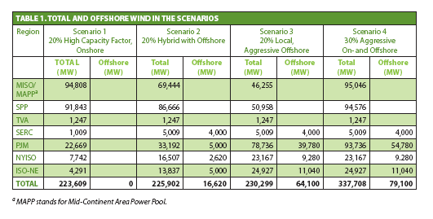
EWITS
24

Slide 25
EWITS
High penetrations of wind generation—20% to 30% of the electrical energy requirements of the Eastern Interconnection—are technically feasible with significant expansion of the transmission infrastructure.
New transmission will be required for all the future wind scenarios in the Eastern Interconnection, including the Reference Case. Planning for this transmission, then, is imperative because it takes longer to build new transmission capacity than it does to build new wind plants.
Without transmission enhancements, substantial curtailment (shutting down) of wind generation would be required for all the 20% scenarios.
25
25
Notes:
25
25

Slide 26
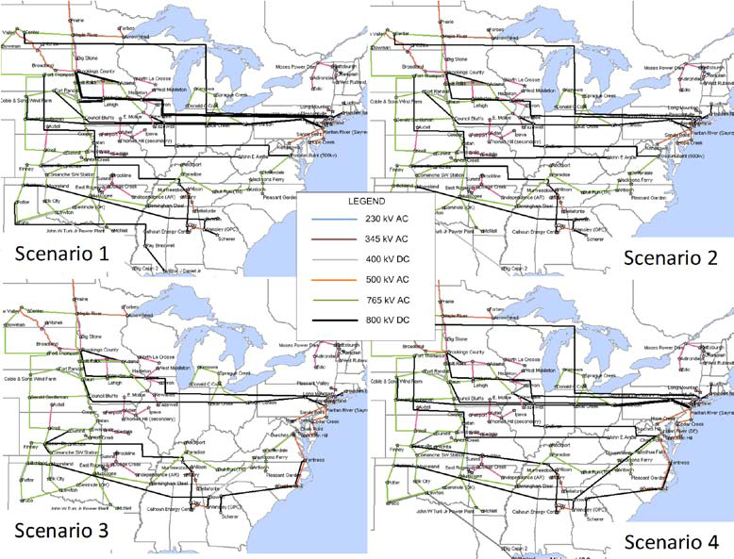
26

Slide 27
EWITS
Interconnection-wide costs for integrating large amounts of wind generation are manageable with large regional operating pools and significant market, tariff, and operational changes.
Transmission helps reduce the impacts of the variability of the wind, which reduces wind integration costs, increases reliability of the electrical grid, and helps make more efficient use of the available generation resources. Although costs for aggressive expansions of the existing grid are significant, they make up a relatively small portion of the total annualized costs in any of the scenarios studied.
27
27
Notes:
27
27

Slide 28
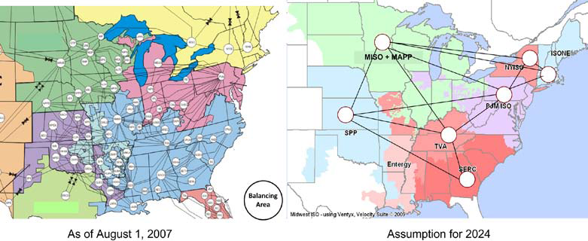
EWITS
28

Slide 29
EWITS
EWITS Website - http://wind.nrel.gov/public/EWITS/
Contact Dave Corbus at David_Corbus@nrel.gov (303-384-6966)
29
Notes:
29
29

Slide 30
Strategic Midwest Area
Renewable Transmission Study
SMART
30
30
Notes:
30
30

Slide 31
SMART
Comprehensive study of the transmission in the Upper Midwest to support renewable energy development and transportation of that energy throughout the study area
Study focus is 20 years into the future (2019, 2024 & 2029 models)
Includes potential effects of future economic, regulatory and state RPS issues
Transcends traditional utility and regional boundaries
31
Notes:
31
31

Slide 32
SMART
Phase 1 evaluation of transmission system
Natural applications of HVDC were considered and the following were applied:
Underwater cables across waterways
Long distance transmission
Two alternatives remain under consideration
Alternative 2 - Combination 345kV and 765kV
Alternative 5 - 765kV only
32
Notes:
32
32

Slide 33
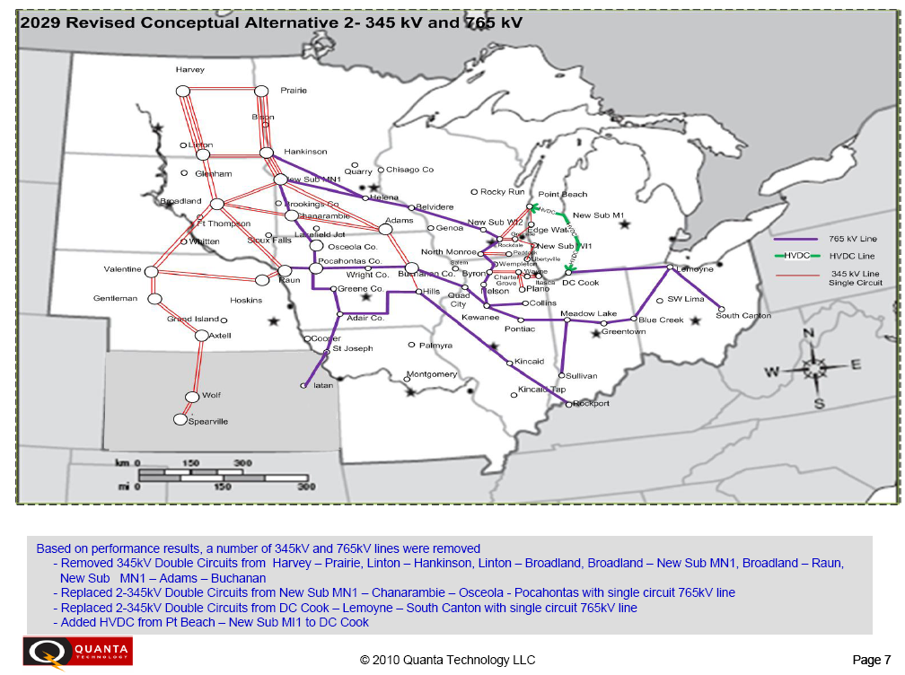
SMART
33
Notes:
33
33

Slide 34
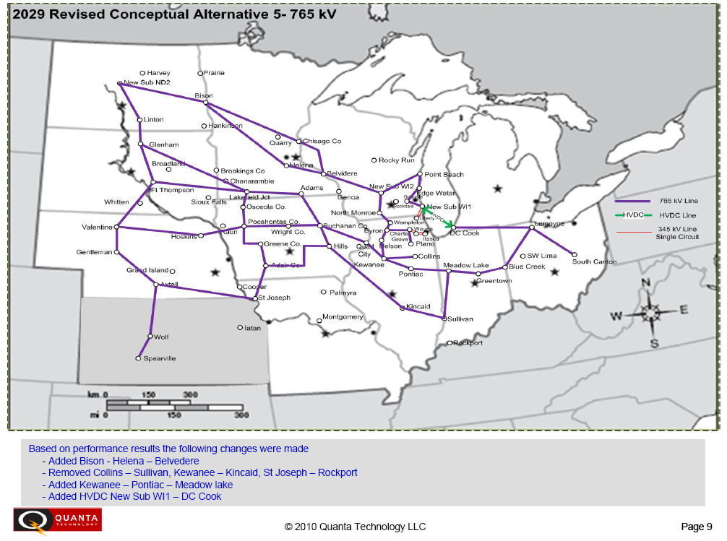
SMART
34
Notes:
34
34

Slide 35
SMART
The reliability impact of the 2 alternatives were evaluated under different sensitivities
On/Off peak
High/Low wind
Imports from SPP
High/Low load
High Gas
Low Carbon
The cost of the 2 alternatives are both in the $25 B range
35
Notes:
35
35

Slide 36
SMART
Phase 2 will further examine the two transmission alternatives using production cost to focus on the overall economic impact
Phase 2 is expected to be complete and a final report issued in late June
36
Notes:
36
36

Slide 37
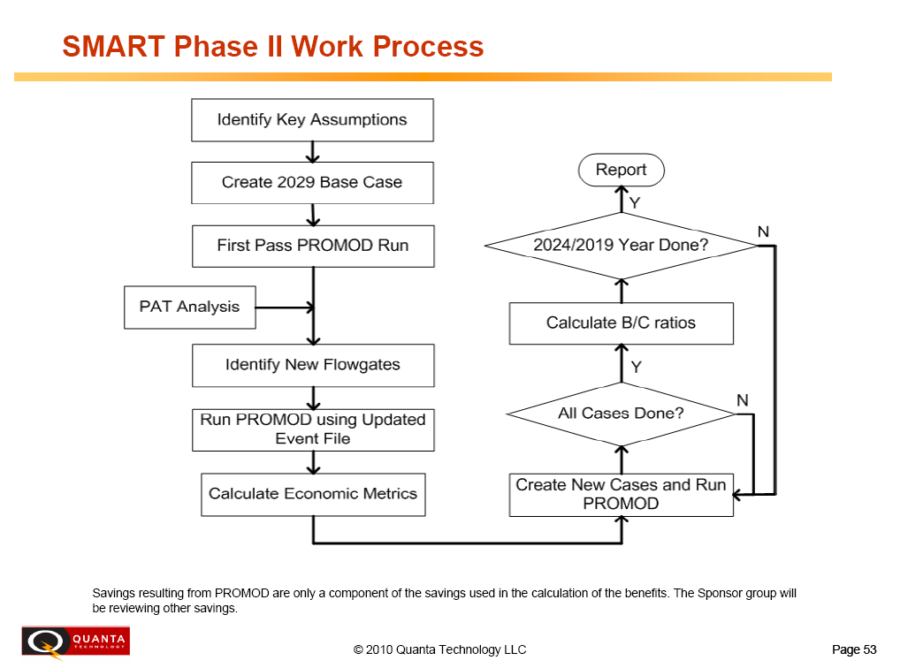
SMART
37
Notes:
37
37

Slide 38
Southeast Inter-Regional Planning Process (SIRPP) Update
NCTPC did not submit requests for study
5 requests selected at the October 2009 meeting
2009 series MMWG 2015 and 2020 Summer Peak cases updated to reflect 2014, 2015, and 2018 Summer Peaks
Studies are under evaluation by study team members, each using their company’s respective planning criteria
Analysis to be completed and Preliminary Report compiled by June 1, 2010
Meeting/Conference Call with stakeholders to discuss preliminary results tentatively planned for June 15, 2010
38
Notes:
38

Slide 39
SIRPP
2009-2010 SIRPP Study Requests
Entergy to Georgia ITS – 2000 MW (2014, Step 2)
MISO to TVA – 2000 MW (2015, Step 1)
Kentucky to Georgia ITS – 1000 MW (2015, Step 1)
MISO & PJM West (SMART) to SIRPP – 3000 MW (2018, Step 1)
SPP to SIRPP – 3000 MW via HVDC (2018, Step 1)
39
Notes:
39
A Step 2 evaluation consists of a detailed evaluation of the requested transfer. This evaluation will identify the final transmission enhancements to resolve the identified constraints. The Step 2 Evaluation reports out on all elements within each of the Participating Transmission Owners’ service areas. The Participating Transmission Owners will also provide detailed cost estimates and timelines associated with the identified transmission enhancements to aid with the stakeholders’ determination of financially sponsoring said enhancements.

Slide 40
PJM Planning Coordination Agreement
2010 PJM RTEP
PJM wind integration studies
Interconnection queue review
CIP-002 philosophy

Slide 41
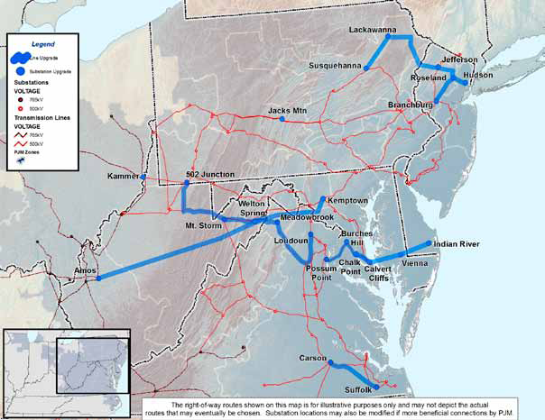
Approved PJM Backbone 500 kV and 765 kV Facilities
Since 2006, the PJM Board has approved six new major 500 kV and 765 kV backbone upgrades, as shown on this map:
502 Junction – Loudoun 500 kV line, also known as the TrAIL Line (2006 RTEP)
Carson – Suffolk 500 kV line (2006 RTEP)
Susquehanna – Roseland 500 kV line (2007 RTEP)
Amos – Kemptown 765 kV line, also known as the PATH line (2007 RTEP)
Possum Point – Indian River 500 kV line, also known as the MAPP line (2007 RTEP)
Branchburg – Roseland – Hudson 500 kV line (2008 RTEP)
Source: PJM 2009 RTEP Report, Feb 26, 2010
3.
6.
1.
4.
5.
1.
4.
2.
41
Notes:
41

Slide 42
SERC LTSG
(Long-term Study Group)
Building 2010 Series models
Coordinated tie lines and interchange
Submitted 10 years of model data for each control area
Building light load case for 2016 and a 2021 winter case
Models to be complete in early June and submitted to the MMWG process
2010 LTSG Study Scope
42
42
42
Notes:
42
42
42

Slide 43
South Carolina Regional Transmission Planning (SCRTP) Meeting Highlights
Preliminary Results of Economic Study Requests Submitted by SCRTP Stakeholders
SCE&G to CPLE – 2015 summer – 500 MW*
SCE&G to Duke – 2015 summer – 500 MW*
SCE&G to CPLE – 2020 summer – 500 MW
SCE&G to Duke – 2020 summer – 500 MW
SCE&G to Southern – 2020 summer – 500 MW * submitted by NCTPC
43
43
Notes:
43
43

Slide 44
SCRTP
Study Methodology – Analysis Performed
Linear transfer analysis, which includes N-1 contingencies of SERC while monitoring SCE&G and Santee Cooper Transmission Systems.
A Thermal and Voltage analysis, which includes N-1, N-2, and selected bus outages with and without the simulated 500 MW transfer in effect. However, this analysis is not a complete testing of NERC TPL standards.
44
44
Notes:
44
44

Slide 45
SCRTP
Preliminary Results - SCE&G to CPLE 500 MW and SCE&G to Duke 500 MW in 2015S *
Urquhart – Langley Tap 115 kV line overload
Estimated cost = $5.1M, 24 month lead time to rebuild
* Each transfer done independently, not simultaneously
45
45
Notes:
45
45

Slide 46
SCRTP
Preliminary Results - SCE&G to CPLE 500 MW in 2020S
Georgia Pacific Tap (SCE&G) – Bush River Red (Duke) 115 kV line overload
A Joint Study between SCE&G and Duke is needed to determine best solution, cost est. and schedule
Santee Cooper’s Pomaria – Winnsboro 69 kV line overload
Estimated cost is $3.6 M, 30 month lead time to rebuild
46
46
Notes:
46
46

Slide 47
SCRTP
Preliminary Results - SCE&G to Duke 500 MW in 2020S
White Rock (SCE&G) - Bush River Yellow (Duke) 115 kV tie line overload
Georgia Pacific Tap (SCE&G) – Bush River Red (Duke) 115 kV line overload
A Joint Study between SCE&G and Duke is needed to determine best solution, cost estimate and schedule to address both overloads
47
47
Notes:
47
47

Slide 48
SCRTP
Preliminary Results - SCE&G to Southern 500 MW in 2020S
White Rock (SCEG) - Bush River Yellow (Duke) 115 kV tie line overload
A Joint Study between SCE&G and Duke is needed to determine best solution, cost estimate and schedule
48
48
Notes:
48
48

Slide 49
SCRTP
Lower Load Forecasts
Both SC companies experienced lower load forecasts for planning horizon
Resulted in future capacity changes for serving load
Resulted in several transmission projects being delayed anywhere from 6 months to several years to even being cancelled
49
49
Notes:
49
49

Slide 50
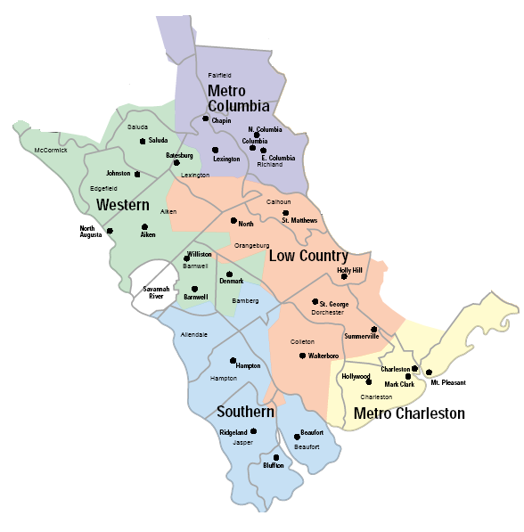
SCRTP
SCE&G New Projected Capacity
2 Nuclear Units (1117 MW/ea)
V. C. Summer #2 - 2016
V. C. Summer #3 - 2019
50
50
Notes:
50
50

Slide 51
SCRTP
Santee Cooper Projected Capacity Update
Pee Dee 609 MW (Planned for Jan 2014) – CANCELED
Pee Dee – Lake City 230 kV Line (Planned for Jan 2011) – DELAYED but still needed in Long-range plan
V. C. Summer #2 and #3 - Shared Capacity with SCE&G
51
51
Notes:
51
51

Slide 52
SCRTP
V.C. Summer Unit #2 Related Projects
Santee Cooper
VCS Sub #1- Winnsboro-Richburg-Flat Creek 230kV 12/01/2015
Winnsboro 230/69kV Construct 12/01/2015
Richburg 230/69kV Construct 12/01/2015
52
52
Notes:
52
52

Slide 53
SCRTP
V.C. Summer Unit #2 Related Projects
SCE&G
Denny Terrace-Lyles 230kV Line Upgrade 12/01/2015
Denny Terrace Add 3rd 336 Autotransformer 12/01/2015
Lake Murray Add 3rd 336 Autotransformer 12/01/2015
Lake Murray-McMeekin 115kV Line Upgrade 12/01/2015
Lake Murray-Saluda 115kV Line Upgrade 12/01/2015
Saluda-McMeekin 115kV Line Upgrade 12/01/2015
VCS2-Lake Murray #2 230kV Line Construct 12/01/2015
VCS2-Winnsboro-Killian 230kV Line Construct 12/01/2015
53
53
Notes:
53
53

Slide 54
SCRTP
V.C. Summer Unit #3 Related Projects
Santee Cooper
VCS Sub2-Pomaria-Sandy Run-Orangeburg- 12/01/2018
St George-Varnville230kV
Sandy Run 230/115kV Construct 12/01/2018
St George 230/115kV Construct 12/01/2018
54
54
Notes:
54
54

Slide 55
SCRTP
V.C. Summer Unit #3 Related Projects
SCE&G
Saluda-Duke 115kV Tielines Upgrade 12/01/2018
South Columbia 230/115kV Construct 12/01/2018
South Lexington 230/115kV Construct 12/01/2018
St George 230kV Switching Station Construct 12/01/2018
St George-Canadys 230kV Line Upgrade 12/01/2018
St George-Summerville 230kV Line Upgrade 12/01/2018
VCS Sub #2-St George 230kV Double Circuit Construct 12/01/2018
55
55
Notes:
55
55

Slide 56
Carolinas Transmission Planning Coordination Arrangement
Establish a forum for coordinating certain planning activities among the specific parties
DEC, PEC, SCE&G and SCPSA
Initial study scope being developed
Expect results in September timeframe
56
56
56
Notes:
56
56
56

Slide 57
Eastern Interconnection Planning Collaborative (EIPC)
57
Notes:
57
57

Slide 58
EIPC
Create an Eastern Interconnection Planning Collaborative (EIPC) process that includes:
Major transmission entities in the east with Planning Authority responsibility
Utilities, cooperatives, municipal systems, and public power authorities
Utilities in Canada (include Quebec)
States and Provinces
Administration (DOE, FERC, …)
A forum where stakeholders from all regional planning processes can effectively participate
58
Notes:
58
Objectives:
EIPC will provide an integrated, interconnection-wide view of regional plans and provide analysis identifying any gaps relative to state, provincial, regional or federal policy goals. This analysis may extend to examining the effectiveness and system impacts of a variety of transmission alternatives
EIPC will use an open and transparent process with a grass-roots approach to the roll-up of regional plans, consistent with FERC Order 890 principles and existing processes
EIPC will not determine cost allocation, will not deal with siting or permitting issues, and will not set or influence energy policy
58

Slide 59
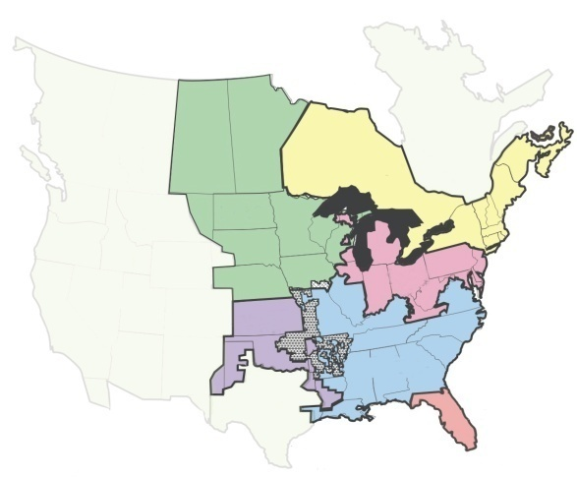
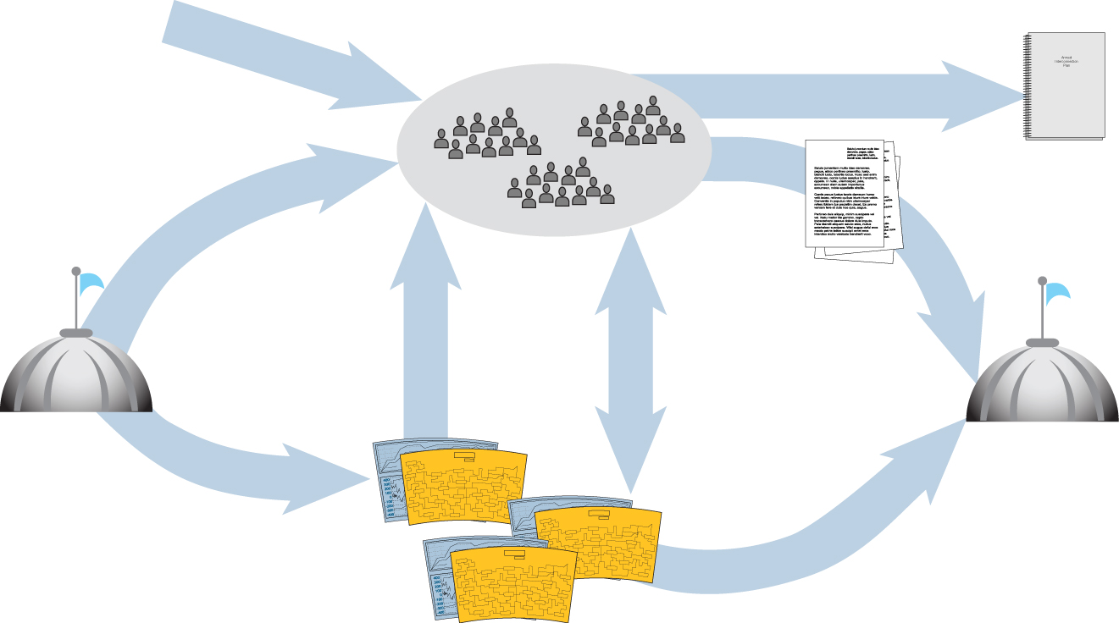
Eastern Interconnection Planning Collaborative
Rolls-up regional plans
Coordinates with Canada, Western Interconnect and Texas
Receives stakeholder input and holds public meetings
Performs studies of various transmission alternatives against national, regional and state energy/economic/environmental objectives
Identifies gaps for further study
Publishes Annual Interconnection Analysis
States
Regional Policy recommendations
State energy policies
Rate Policies
Annual interconnection analysis
Provides
policy direction,
assumptions &
criteria
Regional/state compliant plans provided as input
Study gaps relative
to national, regional and state policy
DOE/FERC
FERC
Review/direction
Order adjustments
Cost recovery
Regional
Plans and Projects
States
Policy recommendations
State energy plans
ISO / RTOs & Order 890 Entities
Produce Regional Plan through regional stakeholder process
59
59
Notes:
59
59

Slide 60
EIPC Activities
Working to finalize stakeholder steering committee structure and representation
PA’s are jointly developing model development/ study practices and working with CRA on economic analysis methods.
For educating stakeholders, coordinate development of a documented roll-up of existing regional transmission plans detailing modeling assumptions for the 2020S model.
Perform TPL standard type analysis of the 2020S model.
60
Notes:
60
60

Slide 61
Questions ?
Notes:
61
61

Slide 62
NERC TPL-001-1 Standard Update
NERC Standards Development Process requires posting and balloting of new/revised standards by the industry
TPL-001-1 covers the fundamental requirements for long term planning
Notes:
62

Slide 63
NERC TPL-001-1 Standard Update
FAILED BALLOT
Quorum: 91.38%
Approval: 35.36%
Notes:
63

Slide 64
NERC TPL-001-1 Standard Update
Common comments
Implementation Plan timeframe
Local Area Load issue
Definition of Protection System
Year One definition
Spare equipment strategy
Protection System modeling
Number of near-term studies
Notes:
Team working to address comments
64

Slide 65
Network BES
Temporary radial

Slide 66
Network BES
No Temporary radial Established

Slide 67
Questions ?
67
67
Notes:
67
67

Slide 68
NERC/FERC Issues
FERC recently issued a series of Orders and NOPR’s
PRC-023
BES definition
TPL-002 R1.3.10 non-operation of protection system
NERC Rules of Procedure on standard development
FERC Penalty Guidelines
68
68
68
68
Notes:
68
68
68
68
Recent FERC orders/NOPR’s on relay loadability (which affect planning practices), footnote b/NCLL, TPL-002 R1.3.10, & BES definition. SDT has prepared footnote b response for ballot.
FERC issued NOPR on NERC Rules of Procedure and ability of industry to vote down a FERC order.
On April 15, 2010, the Federal Energy Regulatory Commission (FERC) announced that it will suspend and open to public comment the Policy Statement on Penalty Guidelines (Policy Statement), which FERC issued on March 18, 2010 in Docket No. PL10-4-000. In suspending the Policy Statement, FERC determined that the public interest would be best served by affording the public an opportunity to comment on the penalty guidelines before putting them into effect. After assessing the public comments received, FERC will determine whether or not to amend the Policy Statement before its adoption.

Slide 69
Questions ?
69
69
Notes:
69
69

Slide 70
2010 TAG Work Plan Review
Rich Wodyka
ITP
70

Slide 71
2010 Overview Schedule
Reliability Planning Process
Evaluate current reliability problems and transmission upgrade plans
Perform analysis, identify problems, and develop solutions
Review Reliability Study Results
Enhanced Access Planning Process
Propose and select enhanced access scenarios and interface
Perform analysis, identify problems, and develop solutions
Review Enhanced Access Study Results
Coordinated Plan Development
Combine Reliability and Enhanced Results
OSC publishes DRAFT Plan
TAG Meetings
TAG review and comment
1st Quarter 2nd Quarter 3rd Quarter 4th Quarter

Slide 72
2010 TAG Work Plan
January - February
Finalize 2010 Study Scope of Work
Receive final 2010 Reliability Study Scope for comment
Review and provide comments to the OSC on the final 2010 Reliability Study Scope including the Study Assumptions; Study Criteria; Study Methodology and Case Development
Receive request from OSC to provide input on proposed Enhanced Transmission Access scenarios and interfaces for study
Provide input to the OSC on proposed Enhanced Transmission Access scenarios and interfaces for study

Slide 73
April - May
TAG Meeting – May 18th
Receive feedback from the OSC on what proposed Enhanced Transmission Access scenarios and interfaces will be included in the 2010 study
Receive a progress report on the 2010 Reliability Planning study activities and results

Slide 74
June - July
2010 TECHNICAL ANALYSIS, PROBLEM IDENTIFICATION and SOLUTION DEVELOPMENT
TAG will receive a progress report from the PWG on the 2010 study
TAG will be requested to provide input to the OSC and PWG on the technical analysis performed, the problems identified as well as proposing alternative solutions to the problems identified
Receive update status of the upgrades in the 2009 Collaborative Plan
TAG will be requested to provide input to the OSC and PWG on any proposed alternative solutions to the problems identified through the technical analysis

Slide 75
August - September
TAG Meeting – September 21st
2010 STUDY UPDATE
Receive a progress report on the Reliability Planning and Enhanced Transmission Access Planning studies
2010 SELECTION OF SOLUTIONS
TAG will receive feedback from the OSC on any alternative solutions that were proposed by TAG members

Slide 76
December
2010 STUDY REPORT
Receive and comment on final draft of the 2010 Collaborative Transmission Plan report
TAG Meeting – December 16th
Receive presentation on the draft report of 2010 Collaborative Transmission Plan
Provide feedback to the OSC on the 2010 NCTPC Process
Review and comment on the 2011 TAG Work Plan Schedule

Slide 77
Questions ?

Slide 78
TAG Open Forum Discussion
Comments or Questions ?
78

